Slide 1
NW411 Network Programming
Fall 2021
Lecture #1
27-sep-2021

Slide 2
Nw411 Summer 2020
BS (CS) Core course.
Course Instructor:
Misbah Anwer, Lecturer (CS)

Slide 3
Outline:
Overview of syllabus and class policies
Learning strategies
Review the concepts of OOP and DCN.
Introduction to web technologies

Slide 4
Nw411Summer 2020
Contact Hours
Monday: (108157) 12:15 pm to 03:15 pm (class breaks as per norm)
Wednesday: (108158) 08:40am to 11:40am (class breaks as per norm)
Email:misbahanwer129@gmail.com, misbah@pafkiet.edu.pk
Interactions : On LMS and Google classroom :
Course Pre-requisites
Object Oriented Programming
Data Communication and Computer Networks.

Slide 5
Evaluation criteria
5 Quizzes (10%)
Assignments (10%)
Project (10%)
Mid Term (30%)
Final (40%)

Slide 6
Course Objectives
Create client and server applications using the "Sockets" API.
Be able to compare, contrast, and critique various networking APIs.
Implement a library reflecting 'publish/subscribe' communication paradigms.

Slide 7
Tentative Course Outline
Java /c# Programming language
Gain more experience in object oriented programming
Program a large project from start to finish
Learn new concepts such as:
Multithreading
Remote Procedure Calls (RPC)
Exception Handling
Security
Concurrency

Slide 8
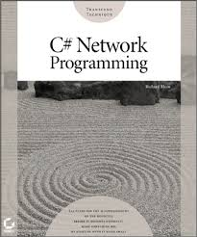
Nw411Summer 2020
By Richard Blum
Textbook
C# Network Programming
by Ricard Blum.
https://faculty.kfupm.edu.sa/ics/fazzedin/COURSES/CSP2005/Reading/NetworkProgramming.pdf
Reference Book:
TCP/IP Illustrated, RFC 1180

Slide 9
Introductory Topics

Slide 10
Programming
Structured vs Non structured languages:
In Structured Programming, the code is divided into functions or modules. It is also known as modular programming. Modules or functions are a set of statements which performs a sub task. As each task is a separate module, it is easy for the programmer to test and debug. It is also easy to do modifications without changing the whole program. When changing the code, the programmer has to concentrate only on the specific module
In Unstructured Programming, the code is written as a single whole block. The whole program is taken as a single unit. It is harder to do changes in the program. This paradigm was used in earlier versions of BASIC, COBOL, and FORTRAN.

Slide 11
Procedural Programming
Procedural Programming can be defined as a programming model which is derived from structured programming, based upon the concept of calling procedure. Procedures, also known as routines, subroutines or functions, simply consist of a series of computational steps to be carried out. During a program’s execution, any given procedure might be called at any point, including by other procedures or itself.
Examples: FORTRAN, ALGOL, COBOL, BASIC, Pascal and C.

Slide 12
Need of OOP
An object-oriented programming is a way programming which enables programmers to think like they are working with real-life entities(a thing with distinct and independent existence) or objects. In real-life, people have knowledge and can do various works. In OOP, objects have fields to store knowledge/state/data and can do various works — methods

Slide 13
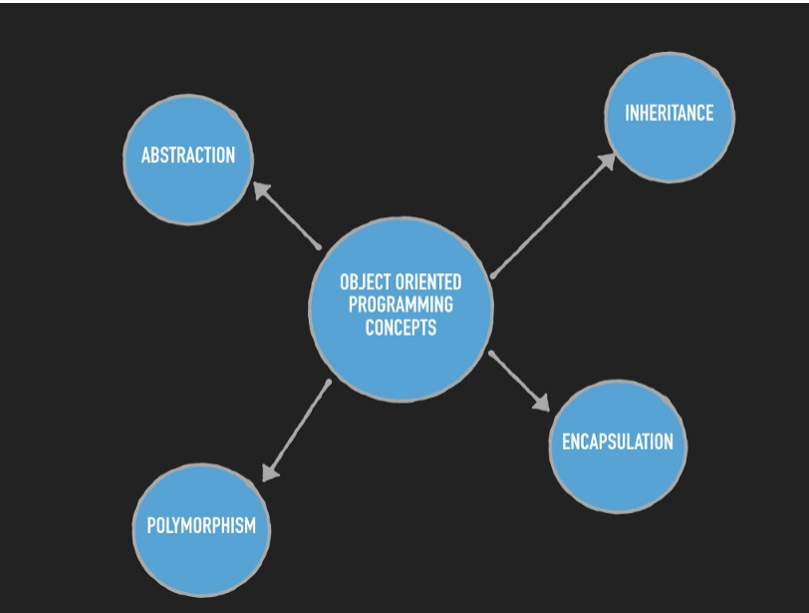
Pillars of OOP

Slide 14
Basic Terminologies:
Object:
It’s the instance of a class/ it’s the working entity of a class.
Class:
It is a template or blue print about the capability of what an object can do.
Method:
The behaviors of a class. It tells what a method can do.
Instance:
Object and Instance both are same with small difference.
A blueprint for a house design is like a class description. All the houses built from that blueprint are objects of that class. A given house is an instance.

Slide 15
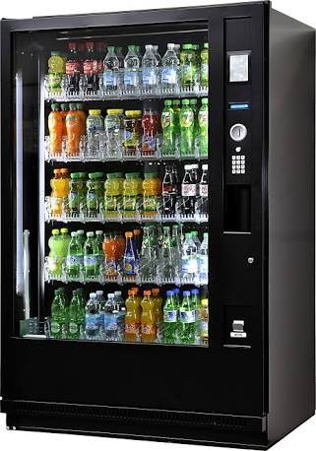
Abstraction and Encapsulation
Encapsulation is a mechanism of wrapping the data (instance variables) and code acting on the data (methods) together as a single unit like a Class.
Here automatic cola vending machine is a class. It contains both data i.e. Cola can and operations i.e. service mechanism and they are wrapped/integrated under a single unit Cola Vending Machine. This is called Encapsulation.
You need not know how the machine is working. This is called Abstraction.
The working and data is hidden from you. This is possible because that Vending machine is made (or Encapsulated or integrated) so. Thus, we can say Encapsulation is a way to implement Abstraction.
Notes:
Encapsulation binds together the data and functions that manipulate the data, keeping it safe from interference and misuse.
Real World Example: Every time you log into your email account( GMail, Yahoo, Hotmail or official mail), you have a whole lot of processes taking place in the backend, that you have no control over. So your password, would probably be retrieved in an encyrpted form, verified and only then you are given access. You do not have any control, over how the password is verified, and this keeps it safe from misuse.
Abstraction is a process of hiding the implementation from the user, only the functionality is exposed here. So you are aware only of what the application does, not how it does it.
Real World Example: When you log into your email, compose and send a mail. Again there is a whole lot of background processing involved, verifying the recipient, sending request to the email server, sending your email. Here you are only interested in composing and clicking on the send button. What really happens when you click on the send button, is hidden from you.
Abstraction : Abstraction is the act of representing essential information without including background details and explanations.
Encapsulation : Encapsulation is the act of wrapping up of attributes(represented by data members) and operations (represented by functions) under one single unit (represented by class).
Taking Real world example
Suppose you go to an automatic cola vending machine and request for a cola. The machine processes your request and gives the cola.

Slide 16
Encapsulation
using System;
using System.Collections.Generic;
using System.Linq;
using System.Text;
using System.Threading.Tasks;
namespace ConsoleApplication4
{
class User
{
private string location;
private string name;
public string Location
{ get
{ return location;}
set
{
location = value; }
}
public string Name
{ get
{ return name;}
set
{
name = value;}}
static void Main(string[] args)
{
User u = new User();
// set accessor will invoke u.Name = "Misbah";
// set accessor will invoke
u.Location = "karachi";
// get accessor will invoke
Console.WriteLine("Name: " + u.Name);
// get accessor will invoke
Console.WriteLine("Location: " + u.Location);
// Console.WriteLine("\nPress Enter Key to Exit..");
Console.ReadLine();
}
}
}

Slide 17
Differences
Global variables are declared outside any function, and they can be accessed (used) on any function in the program. Local variables are declared inside a function, and can be used only inside that function.
Overloading and Overriding

Slide 18
Computer Networks
A computer network is a set of connected computers. Computers on a network are called nodes. The connection between computers can be done via cabling, most commonly the Ethernet cable, or wirelessly through radio waves. Connected computers can share resources, like access to the Internet, printers, file servers, and others. A network is a multipurpose connection, which allows a single computer to do more.
Computer networks can be broken down historically into topologies, which is a technique of connecting computers.

Slide 19
Network Protocol
A network protocol defines rules and conventions for communication between network devices. Network protocols include mechanisms for devices to identify and make connections with each other, as well as formatting rules that specify how data is packaged into sent and received messages. Some protocols also support message ​acknowledgment and data compression designed for reliable and/or high-performance network communication

Slide 20
How does the Internet Work?
Through communication protocols
A communication protocol is a specification of how communication between two computers will be carried out
IP (Internet Protocol): defines the packets that carry blocks of data from one node to another
TCP (Transmission Control Protocol) and UDP (User Datagram Protocol): the protocols by which one host sends data to another.
Other application protocols: DNS (Domain Name Service), SMTP (Simple Mail Transmission Protocol), and FTP (File Transmission Protocol)

Slide 21
The Internet Protocol (IP)
A key element of IP is IP address, a 32-bit number
The Internet authorities assign ranges of numbers to different organizations
IP is responsible for moving packet of data from node to node
A packet contains information such as the data to be transferred, the source and destination IP addresses, etc.
Packets are sent through different local network through gateways
A checksum is created to ensure the correctness of the data; corrupted packets are discarded
IP-based communication is unreliable

Slide 22
The Transmission Control Protocol (TCP)
TCP is a higher-level protocol that extends IP to provide additional functionality: reliable communication
TCP adds support to detect errors or lost data and to trigger retransmission until the data is correctly and completely received
Connection
Acknowledgment

Slide 23
OSI Model
Open Systems Interconnection Basic Reference Model (OSI Reference Model or OSI Model) is an abstract description for layered communications and computer network protocol design. It was developed as part of the Open Systems Interconnection (OSI) initiative. In its most basic form, it divides network
architecture into seven layers which, from top to bottom, are the Application, Presentation, Session, Transport, Network, Data-Link, and Physical Layers. It is therefore often referred to as the OSI Seven Layer Model.

Slide 24
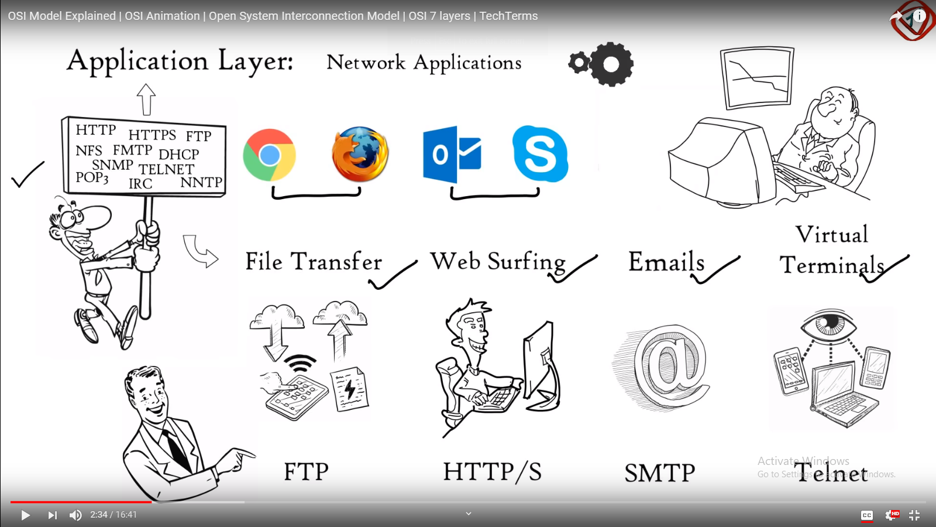

Slide 25
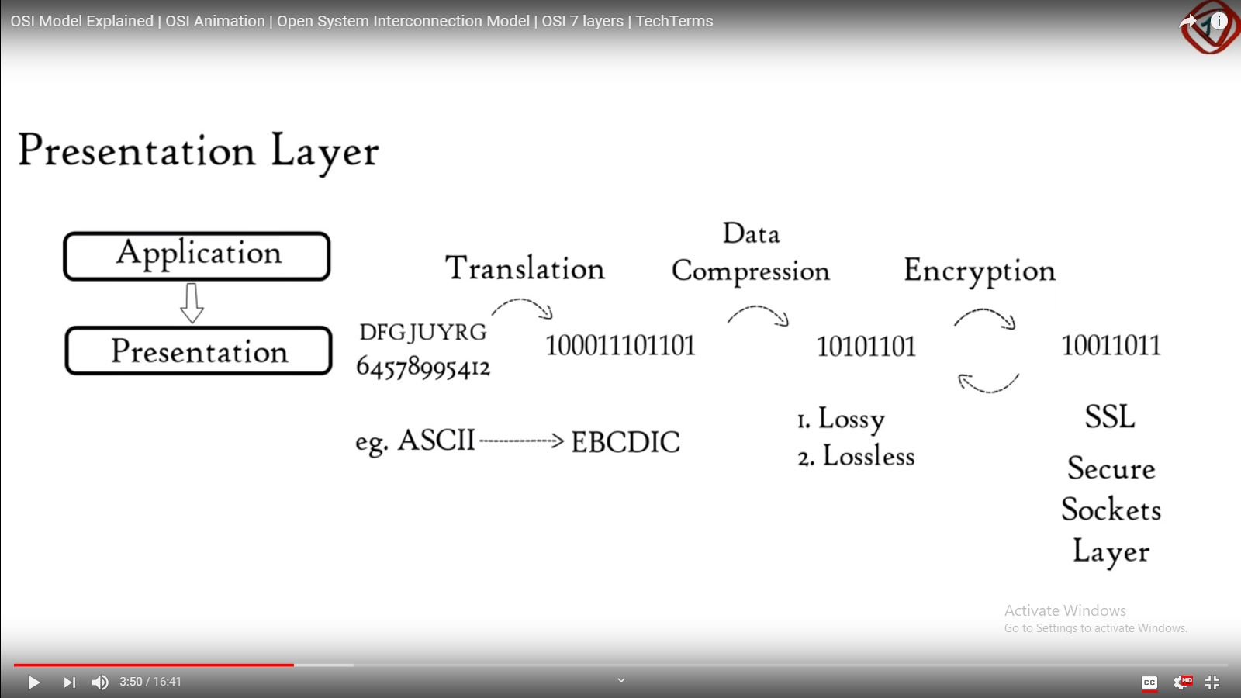

Slide 26
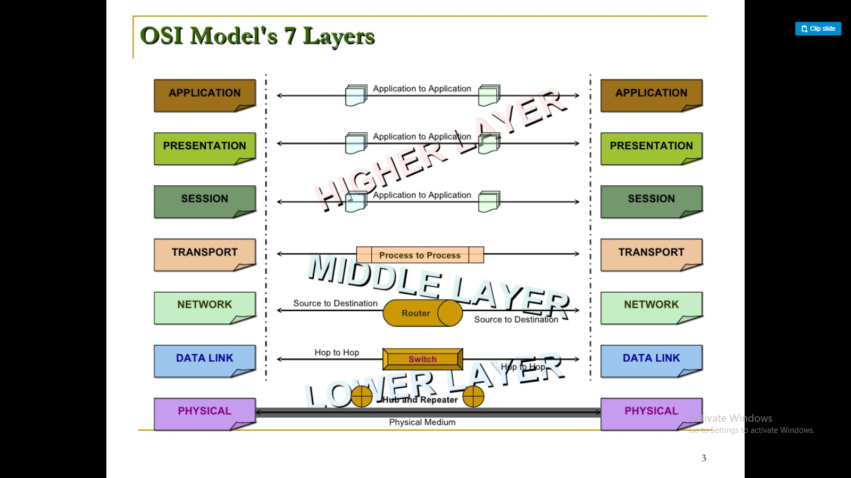
OSI Model

Slide 27
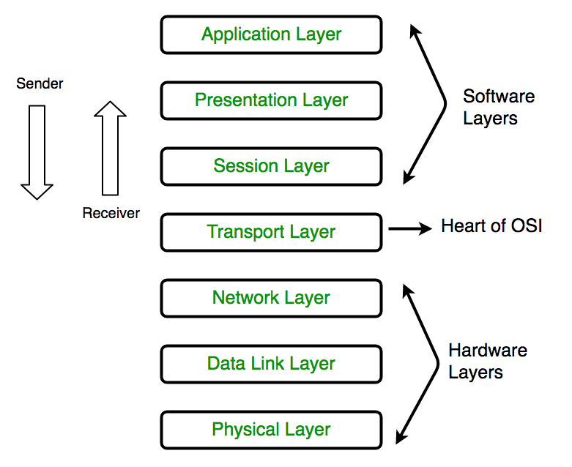
OSI

Slide 28
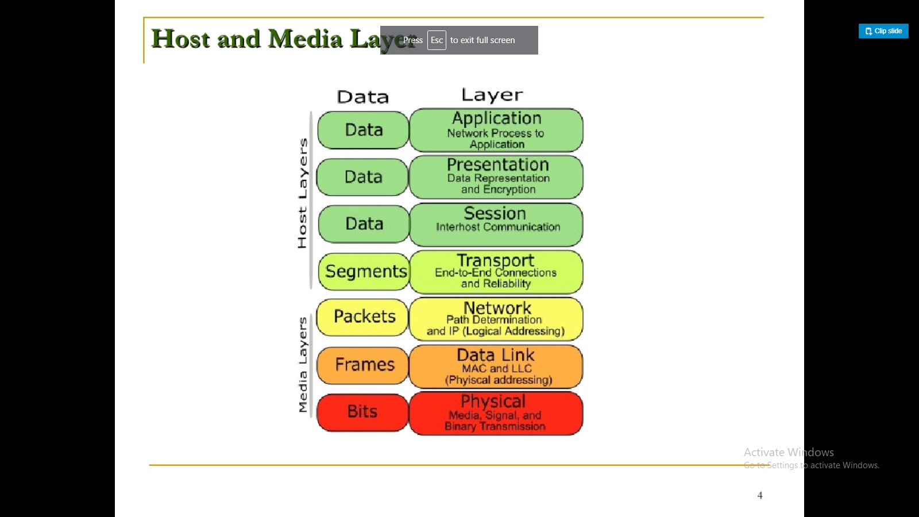
Host and Media Layer

Slide 29
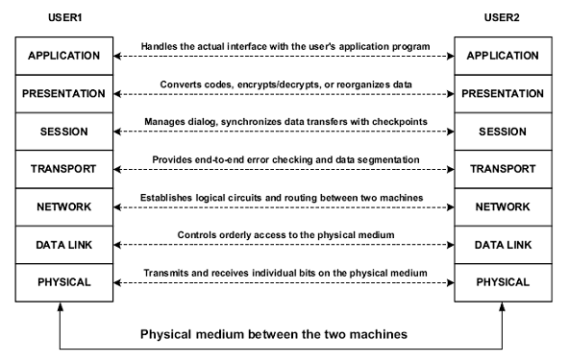

Slide 30
TCP/IP protocol
The TCP/IP protocol suite was developed prior to the OSI model. Therefore, the layers in the TCP/IP protocol suite do not match exactly with those in the OSI model. The original TCP/IP protocol suite was defined as four software layers built upon the hardware. Today, however, TCP/IP is thought of as a five-layer model with the layers named similarly to the ones in the OSI model.

Slide 31
TCP/IP Protocol Suites
The TCP/IP model is a concise version of the OSI model. It contains four layers, unlike seven layers in the OSI model. The layers are:
Process/Application Layer
Host-to-Host/Transport Layer
Internet Layer
Network Access/Link Layer

Slide 32
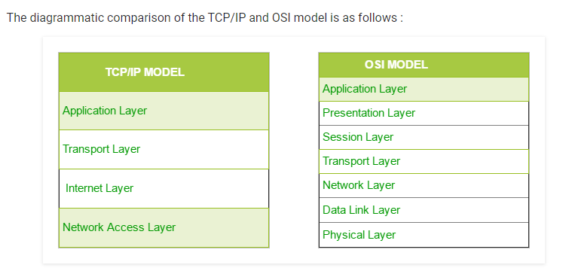
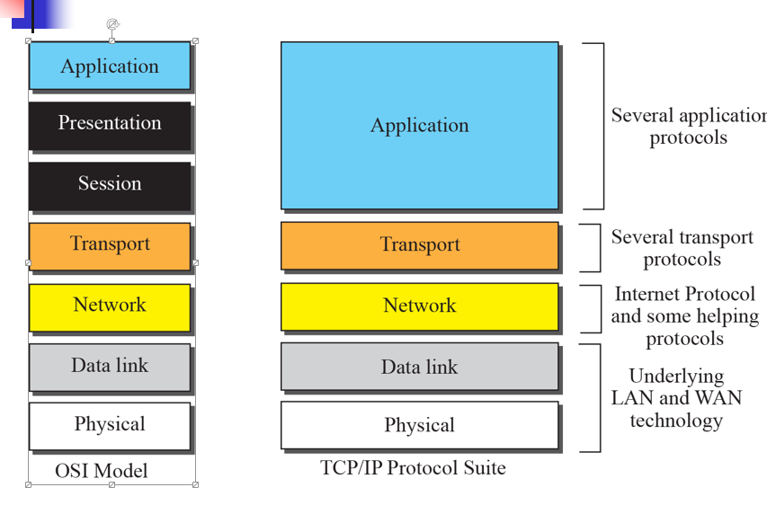
TCP/IP and OSI model

Slide 33
CLR Environment:
Notes:
The layout of how application programs run in the CLR environment is shown in Figure 1.1. High-level applications
written in various .NET languages, such as Visual Basic .NET, Visual C++ .NET, Visual J# .NET, and of course
Visual C# .NET, are compiled into a special intermediate language called Microsoft Intermediate Language (MSIL)
. The MSIL code is interpreted by the CLR as the program runs; MSIL runs on the host operating system as a
normal executable program.

Slide 34
Client server model
Suppose a user is browsing the Internet and types ‘yahoo.com' into their browser bar. This results in a request to DNS servers for the IP address of yahoo.com, and the DNS servers respond to this request by serving the IP address to the browser. Next, the user's browser makes a request to yahoo servers (using the IP address) for the content that appears on the page, and the browser loads the page on the client device

Slide 35
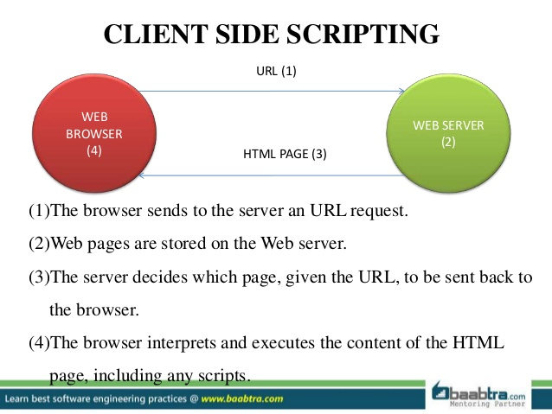

Slide 36
Client Side vs. Server Side Web
Simply defined, client-side code executes on the end-user's computer, usually within a web browser.
Server-side code executes on the web server, usually within a web application environment, which in turn generates HTML to be viewed in a browser.

Slide 37
Client Side vs. Server Side Web
Which one to choose? What are the determining factors?
Performance:
Responsiveness, speed, reliability
Ability to handle a large number of simultaneous users
Functionality:
Simplicity of use and maintenance,
Breadth of user options
Ability to handle multiple simultaneous transactions
Security:
Desktop security
Server security
Database security
Network security

Slide 38
Client Side Technologies
HTML : markup language for display of web content
DHTML extensions for dynamic and interactive control of web page content and display
Tools for writing html documents include : Dreamveawer, FrontPage and any word processor (including Notepad)
JavaScript: client side programming language
VBScript: client side programming language

Slide 39
Client Side Technologies: summary
Client Side technologies have evolved form a simple tools for creating static pages to sophisticated array of technologies turning a browser into a powerful multifunctional client
Consequently, we can stop referring to a web client as “thin” client (i.e. limited in size and computational needs)

Slide 40
Server Side Technologies
Server-side technologies are quite numerous and diverse. Popular server side web application technologies include:
Microsoft ASP/.NET
Java server technologies such as J2EE, JSP, and servlets
CGI (common gateway interface)/ Perl
PHP
ColdFusion

Slide 41
Server Side Technologies: ASP/.NET
.NET is Microsoft framework supports many programming languages such as VB, C++, C#, JScript
One application can have components written in multiple languages
ASP.NET (Active Server Pages) is an integral part of .NET initiative
It is a technology for creating dynamic web content on the server that appears as HTML on a client’s browser
Developers can use this technology to write scripts in a language of their choice for from processing, interactive web pages, or any other dynamic content
Every element in an ASP.NET page is treated as an object and run on the server.
ASP.NET server controls are components that can perform the same work as HTML controls: radio buttons, text boxes, buttons, etc.
Unlike HTML controls, ASP.NET controls preserve their content if and when this is needed

Slide 42
Practical
Implement 4 pillars
Working Button in form
Hello world on web (ASP.net)

Slide 43
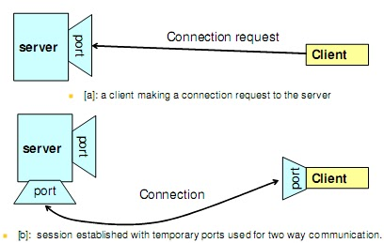
Socket programming
Socket programming is a way of connecting two nodes on a network to communicate with each other. Basically, it is a one-way Client and Server setup where a Client connects, sends messages to the server and the server shows them using socket connection. One socket (node) listens on a particular port at an IP, while other socket reaches out to the other to form a connection. Server forms the listener socket while the client reaches out to the server

Slide 44
Create Server
IPAddress ip = IPAddress.Any;
IPEndPoint ep = new IPEndPoint(ip, 2000);
Socket sk = new Socket(ip.AddressFamily, SocketType.Stream, ProtocolType.Tcp);
sk.Bind(ep);
Console.WriteLine("server waiting");
sk.Listen(1);
Socket cl = sk.Accept();
Console.WriteLine("connected");

